Slide 2
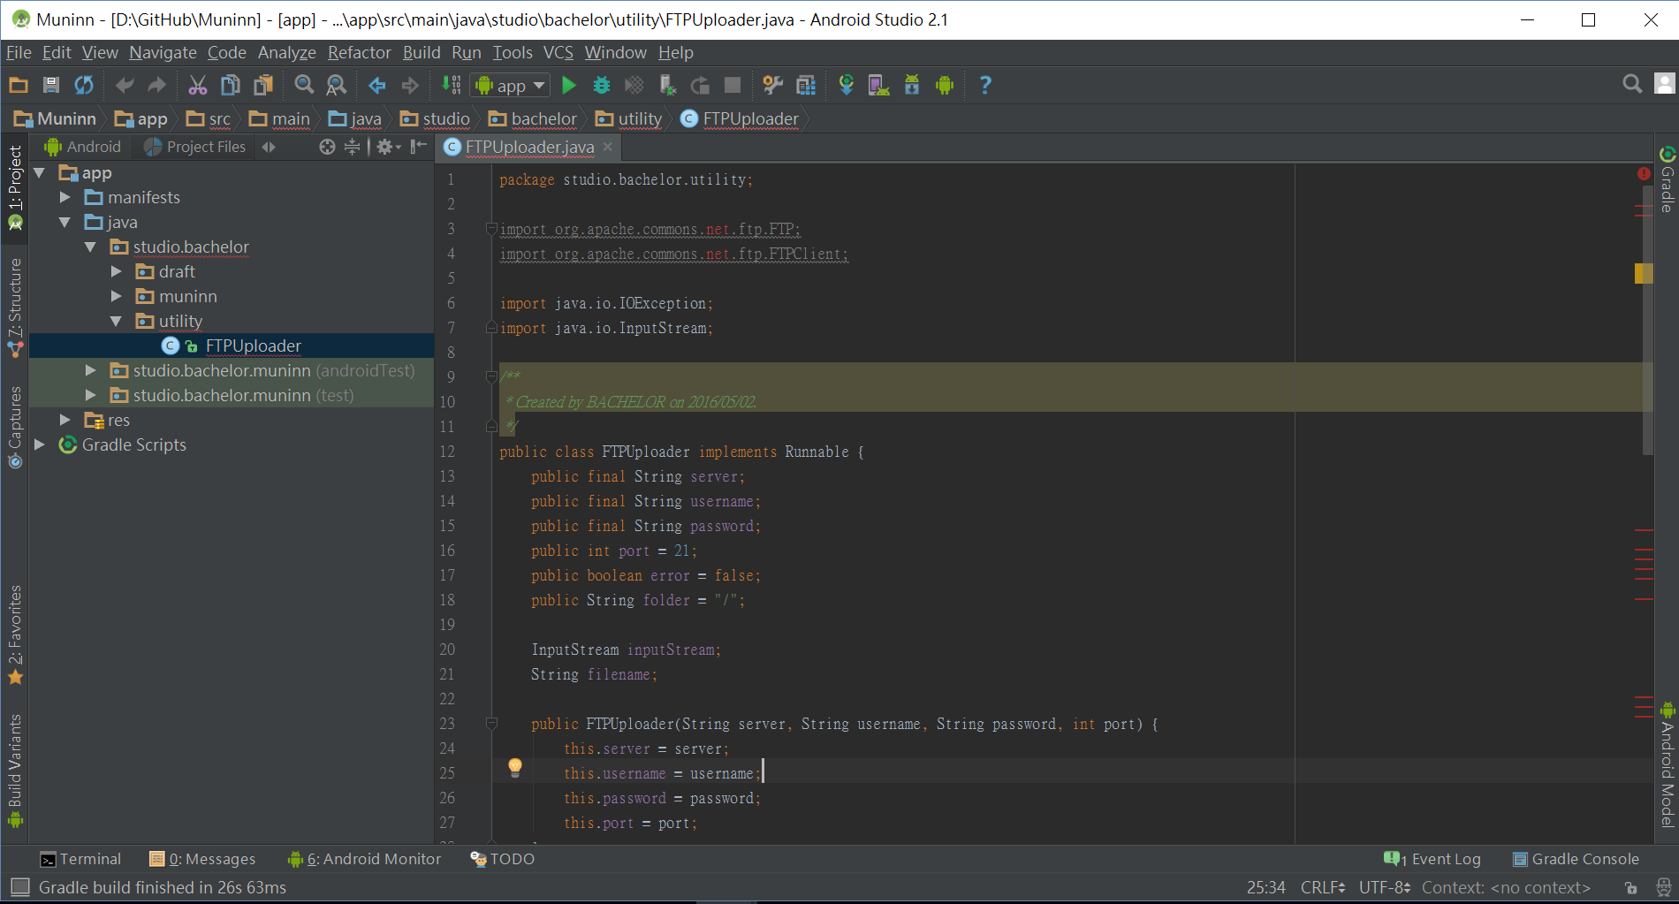
FTPUploader exisit ERROR

Slide 3
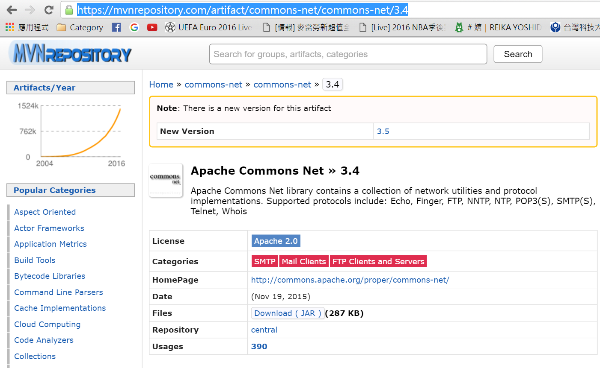
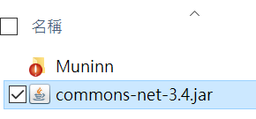
Download Apache Library:
https://mvnrepository.com/artifact/commons-net/commons-net/3.4

Slide 4
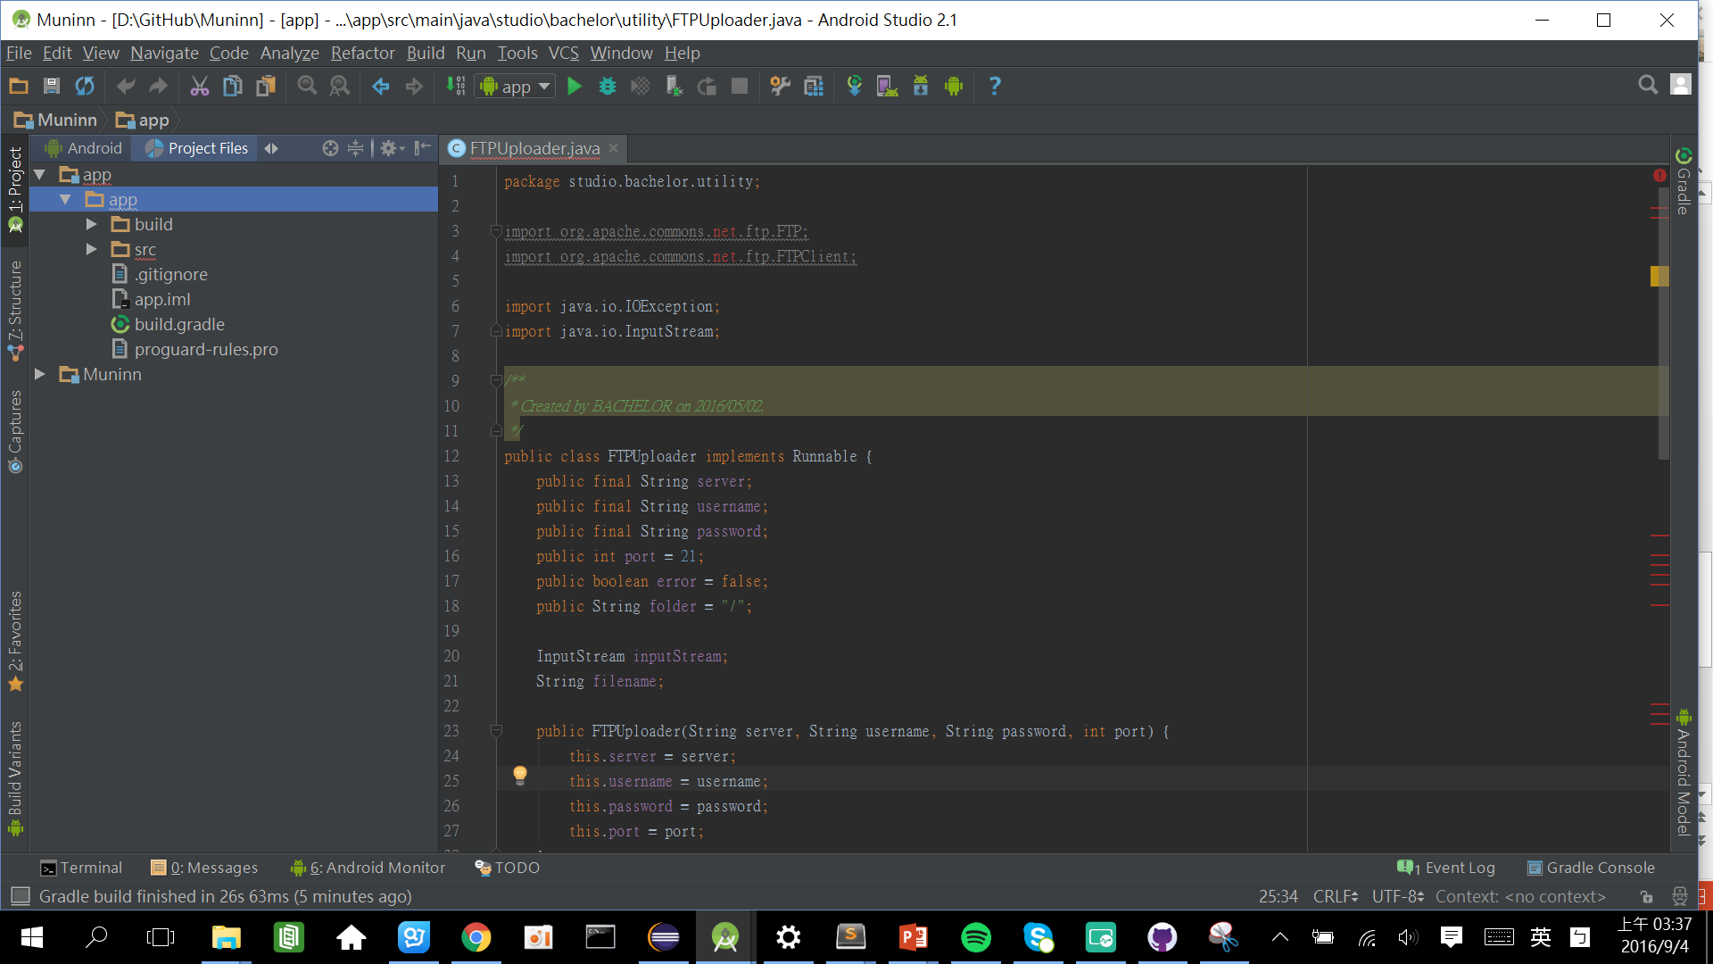
Select “Project Files” show tree-directory

Slide 5
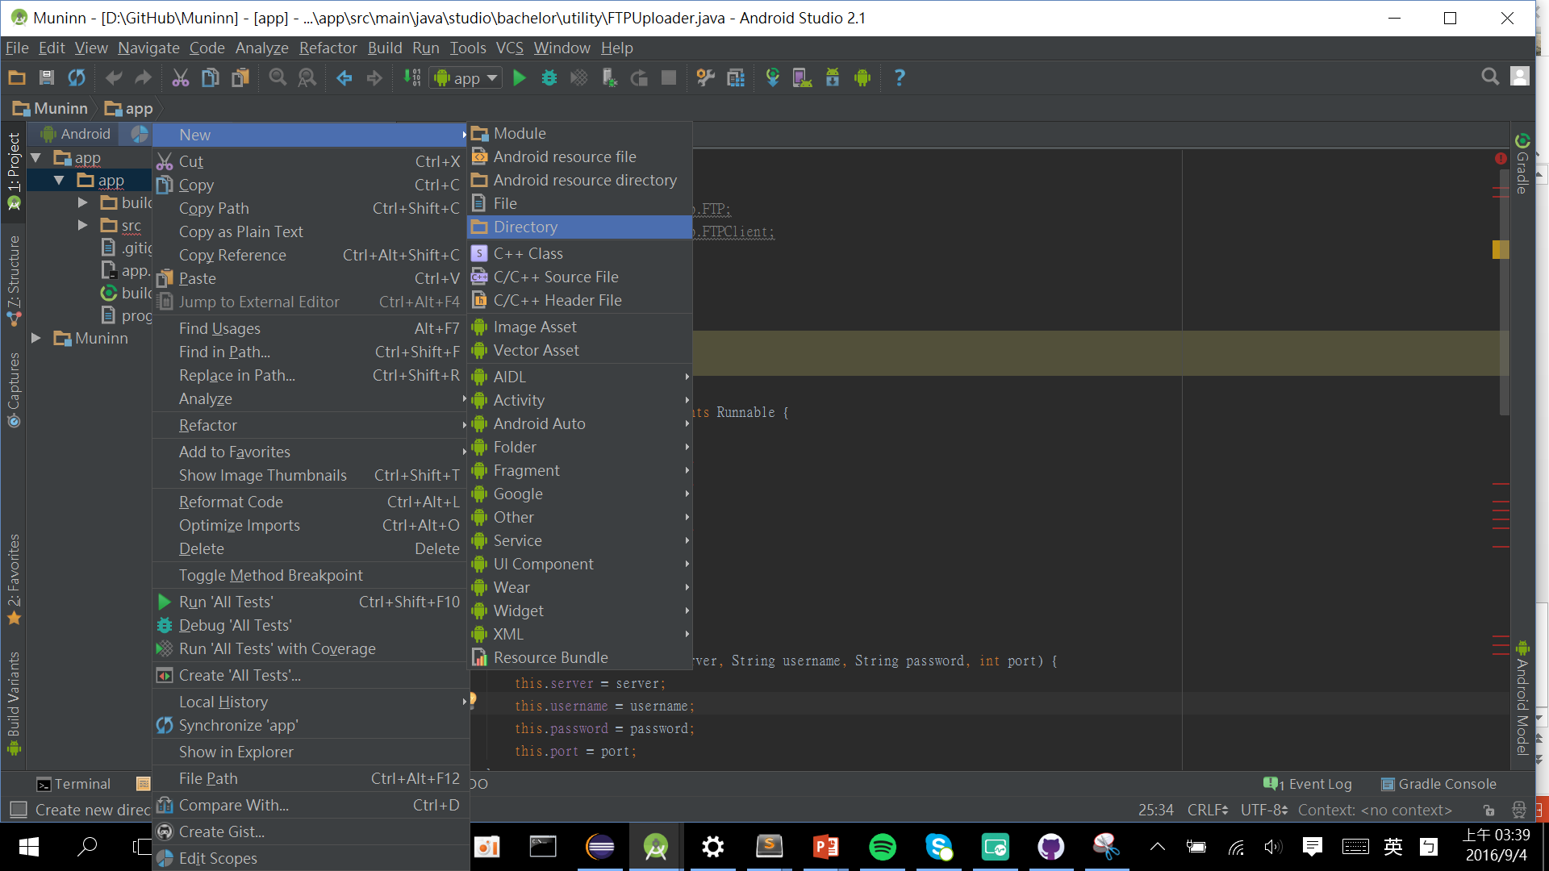
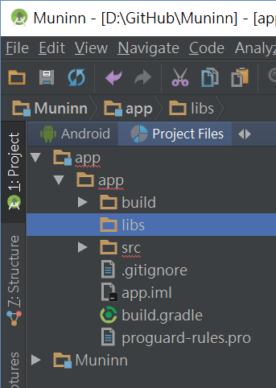
If there isn’t exist “libs” dir., create a new one.

Slide 6
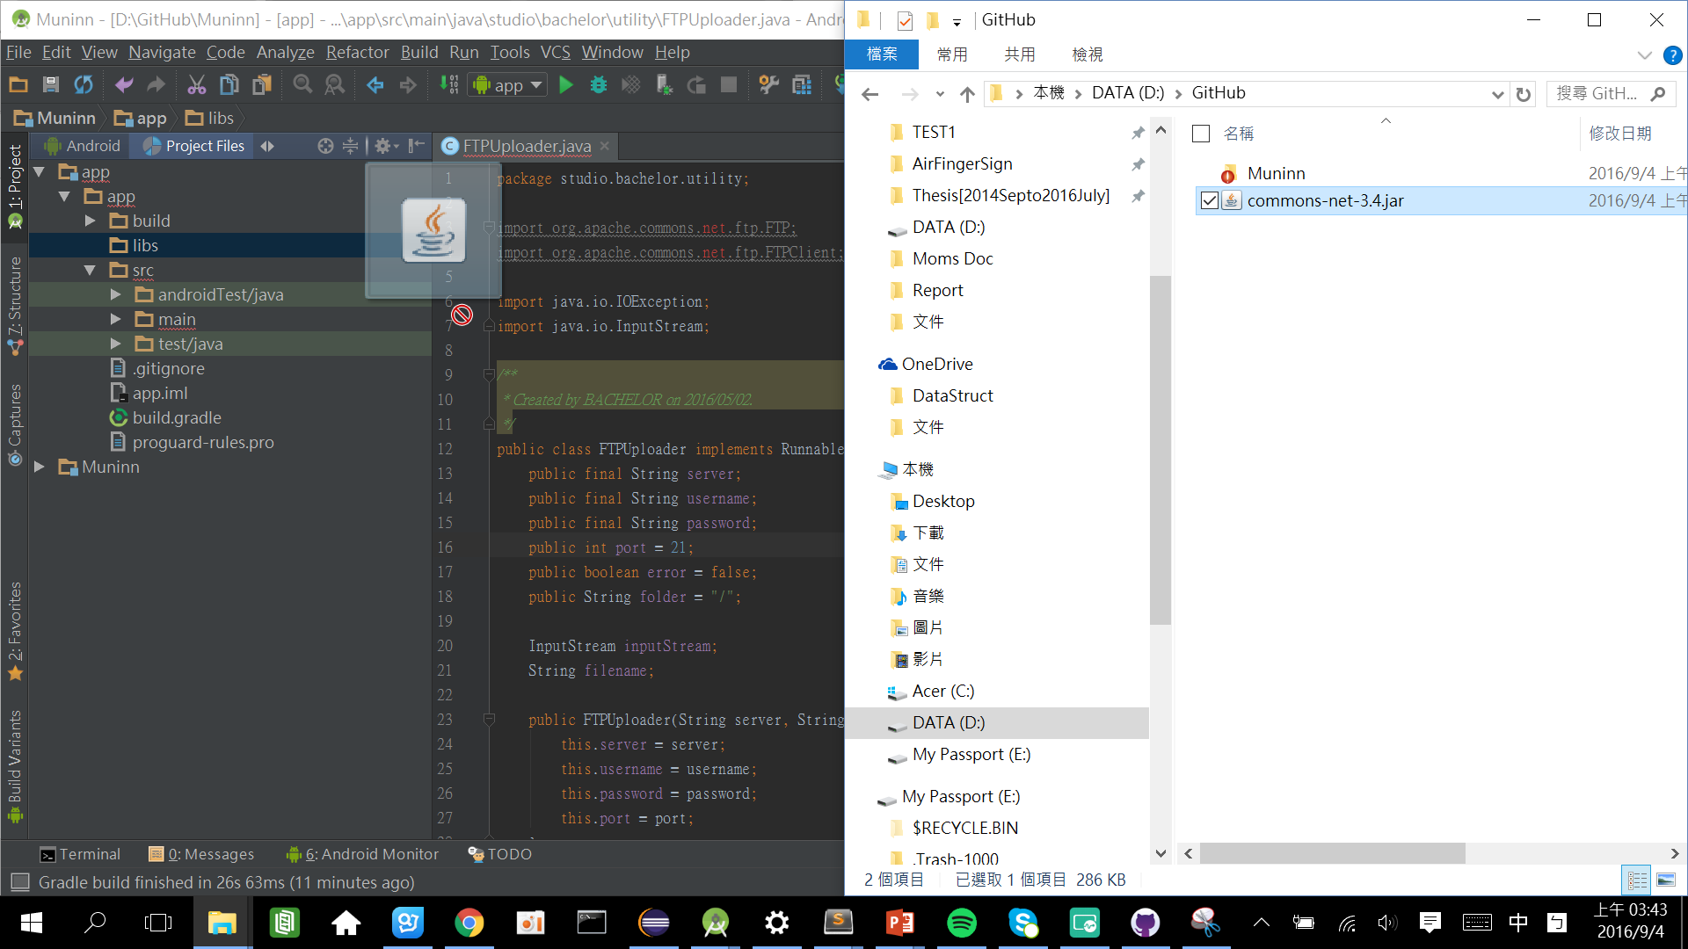
Cope the library file to “libs”

Slide 7
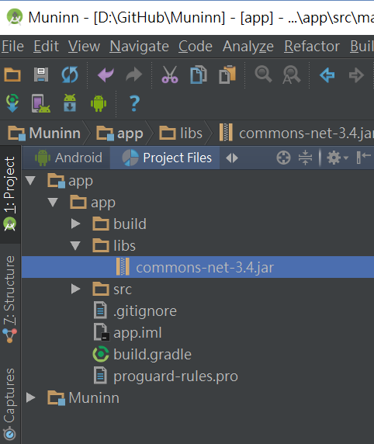
You will see the “commons-net-3.4.jar” that is under libs.

Slide 8
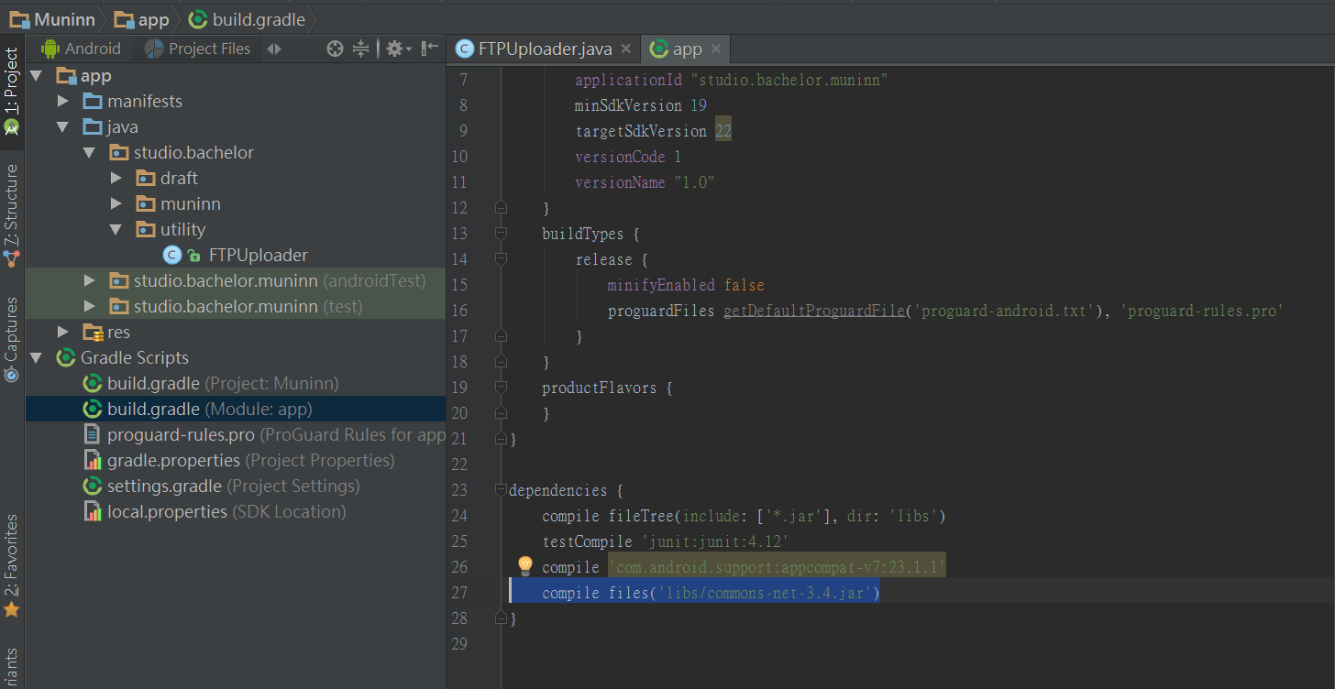
Be careful the dependencies of compile files name at build.gradle(Module: app)
compile files('libs/commons-net-3.4.jar')

Slide 9
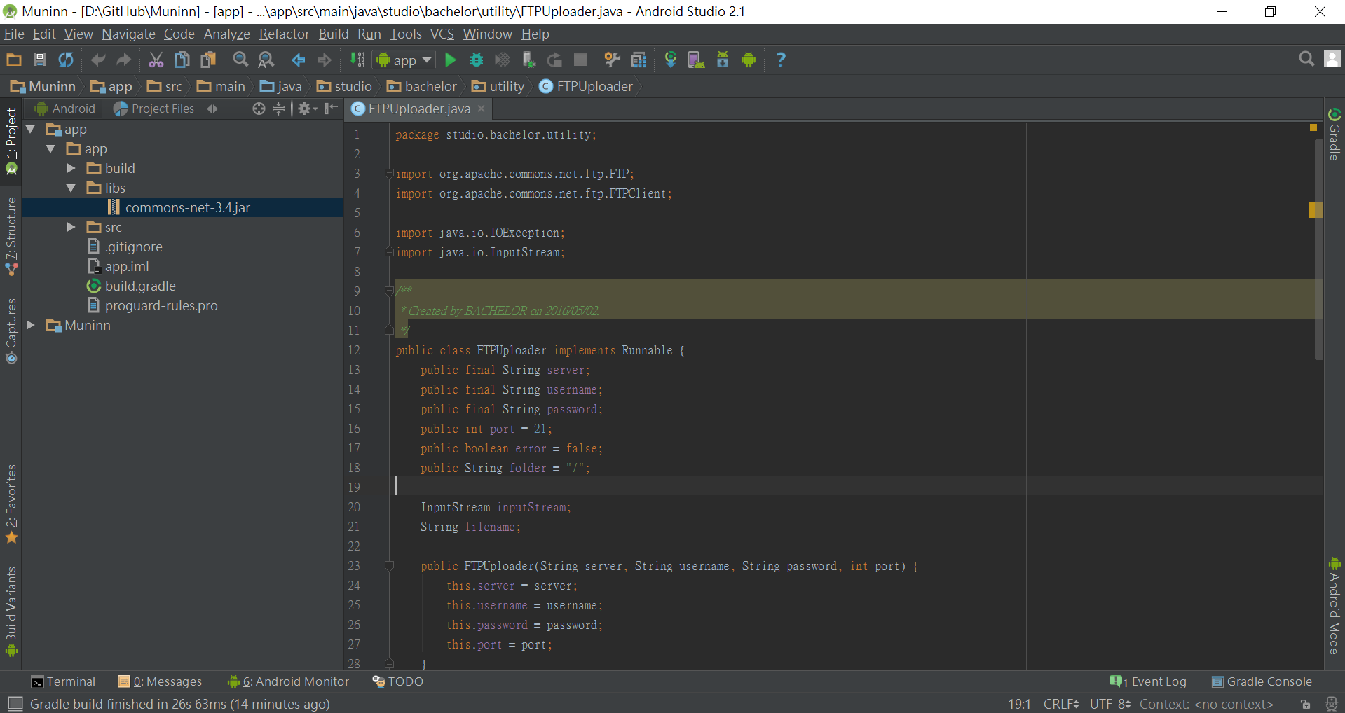
Import will be Success.

